Slide 1


SOCIAL
BUZZ
ANALYSIS

Slide 2


Today's agenda
Project recap
Problem
The Analytics team
Process
Insights
Summary

Slide 3

Social Buzz, founded by two former engineers from a social media conglomerate, aims to create a content-focused platform where user anonymity is maintained, and trending content takes precedence over individual users through a wide range of reaction options.
Project Recap
Social Buzz, with over 500 million monthly active users, seeks an advisory firm's assistance in managing their rapid scaling process and handling the massive amount of unstructured data generated by their digital platform.

Slide 4

Problem
1) They are looking to complete an IPO by the end of next year and need guidance to ensure that this goes smoothly.
2) They are still a small company and do not have the resources to manage the scale that they are currently at. They could hire more people, but they want an experienced practice to help instead.
3) They want to learn data best practices from a large corporation. Due to the nature of their business, they have a massive amount of data so they are keen on
understanding how the world's biggest companies manage the challenges of big data.

Slide 5



Andrew Fleming (Chief Technical Architect)
The Analytics team
Marcus Rompton (Senior Principle)
Myself
(Data Analyst)

Slide 6
Process
1
Data Understanding
2
Data Cleaning
3
Data Modeling
4
Data Analysis
5
Generate Insights

Slide 7

Insights
16
1897
January
Unique
categories
Reaction to animal post
The month with most posts.

Slide 8
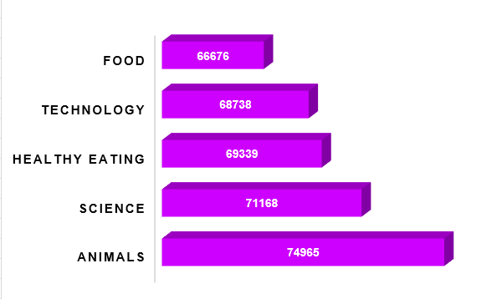
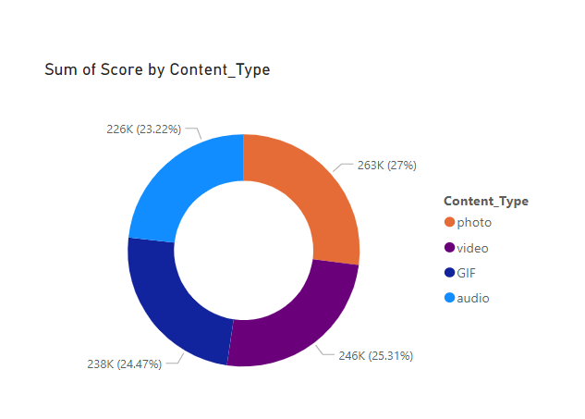

Slide 9
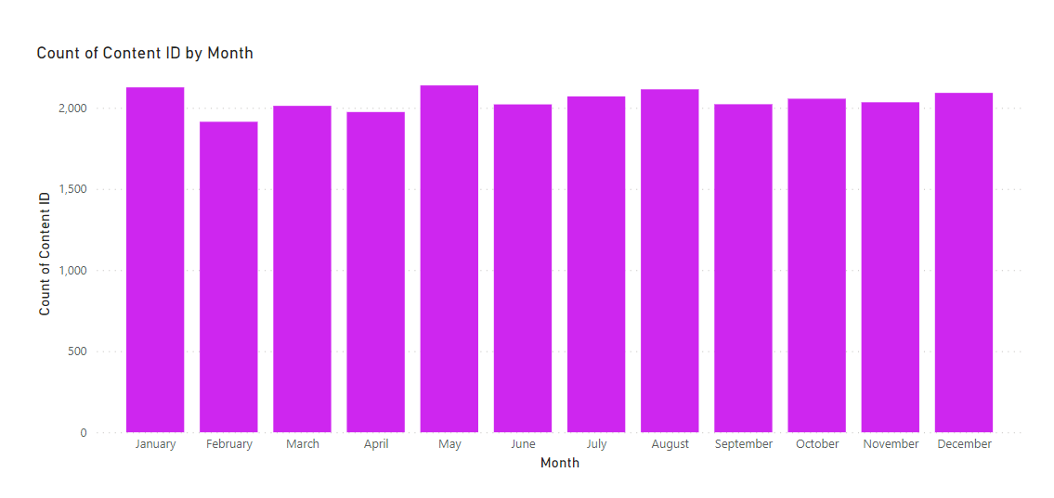
Value count Content Per Month

Slide 10

1. We saw which categories are most popular in which month, and overall ‘Animal’ came out to be top category. We also saw most posts were made in January.
Summary
2. The score for positive news is highest that shows mostly people like positive things in their feed.
3. We also studied the Content type and found that Photo Content scored best.

Slide 11
Thank you!
ANY QUESTIONS?

